Slide 1
Creating Online Communities of Learning by Using Social Media
Andy Gavrin
IUPUI

Slide 2
Setting
Calculus-based mechanics
150 – 175 students
Urban public institution
Traditional & nontraditional students

Slide 3
CourseNetworking
Social media site for course setting
“Facebook/LMS hybrid”
Student centered
Promotes connections
Mild “gamification”

Slide 4
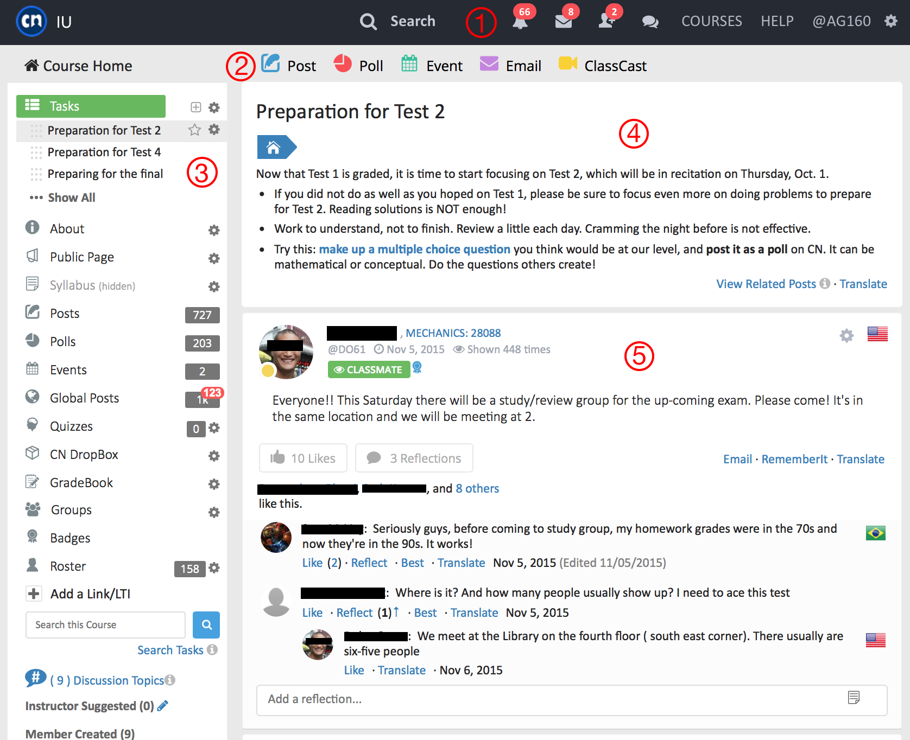
Notes:
Anatomy of CN

Slide 5
My goals for CN
Teaching: enhance engagement
Students share knowledge
Students share enthusiasm
Students share concerns
Students build identity
Research: understand engagement
Does it work?
How, and for whom?

Slide 6
More student posts

Slide 9
Community Building
Hey team! I just wanted to wish you guys good luck tomorrow. Normally the test is not hard but I just wish I knew what exactly to study.
Thank you, [original poster]! Best of luck to you, as well. These next few weeks are going to be tough.
im not thinking this test will go too well, Im hoping that it will be easier than anticipated but not sure about what to expect on it
Notes:
“Hey Team”!

Slide 10
Student Attitudes
Questions (paired) | Yes (%) | No (%)
1a. Does CN help you stay caught up in this course? | 74.0 | 26.0
1b. Do your other courses have systems that are more effective in helping you stay caught up? | 20.2 | 79.8
2a. Does CN help you stay interested in the course? | 61.2 | 38.8
2b. Do your other courses have systems that are more effective in helping you stay interested? | 20.4 | 79.6
3a. Does CN help you make connections with other students? | 73.2 | 26.8
3b. Do your other courses have systems that are more effective in helping you make connections? | 18.4 | 81.6

Slide 11
Summary
An effective communication tool
Engages students with physics
Engages students with one another
Good faculty tools to “guide”

Slide 12
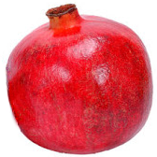
Anar Seeds
Student actions gain “Anar Seeds” a “micro-reward”
Extra credit (capped at 5%) for gaining 350 seeds during semester
350 seeds = 50 logins + 10 posts + 10 reflections + 25 polls answered+ 50 likes
Highly customizable

Slide 13
Differential Use by Gender
Females earn ~20% more seeds
Significant at p < 0.05, Cohen’s d = 0.35

Slide 14
CN vs. Engagement (HW)
Notes:
Non-normal statistics, ceilings and floors

Slide 15
Sentiment time series

